Slide 1



Memory Boxes: a Garden of Reminescence
Deinde Ltd.
Results of questionnaire about memories

Slide 2
SEX | WOMEN | MEN
 | 11 | 10
AGE | UNDER 40 | ABOVE 40
 | 13 | 8
EDUCATION | PRIMARY | HIGH-SCHOOL | UNIVERSITY
 | 0 | 5 | 16
WOMEN AGES |  | MEN AGES
UNDER 40 | ABOVE 40 | UNDER 40 | ABOVE 40
7 | 4 | 7 | 3
WOMEN EDUCATION |  | MEN EDUCATION
HIGH-SCHOOL | UNIVERSITY | HIGH SCHOOL | UNIVERSITY
3 | 8 | 1 | 9

Slide 3
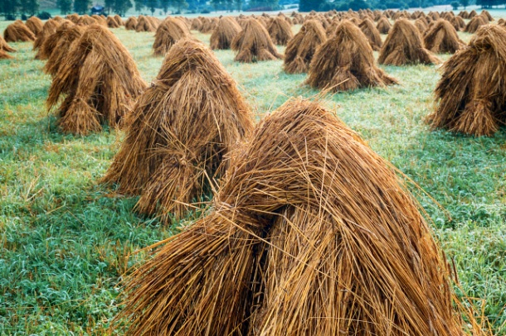
1. When you think about your childhood what images/ scenes come to your mind?
relax in Sunday’s afternoon nearby the forest
Family house, Christmas, family
Forest
Street where I live, my grandma
Carelessness, joy, sun and amusement
Sport competition
Football, walk with my father
Holidays at the countryside (2), at grandma’s house
Dog that pulled me and my sister on the sledge in winter
Summer, harvest, thunderstorm, mud
Sleeping on hay/straw
Snowy countryside, wild forest during summer, river where
I used to bath, blankets put on the grass (during picknic

Slide 4
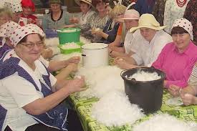
I did’t have any other entertainments than plays with my colleagues
Catching crayfishes
Playing in sandbox, in a swing
Activness, riding on bicycle
Walking harefoot on puddles
Fishing
Walking in the mountains
I remember when I was a small girl
I „played” in priest and my grandma
permitted me for it and replied my
prayes, my grandma singing, my grandfathers, one who
one liked hunting and muchrooming very
much and other was chairman
of firemen in the village and mayor
of the village during 25 years
my favourite dress on white circles
At times of my childhood people had time on everything, in the evenings they sat down on the grass and talked, danced, in winter met at homes and teared plumage, people lived very modestly and everybody was happy from that he/she had, people appreciated and respected what they have, peole didn’t have such clothes as now

Slide 5
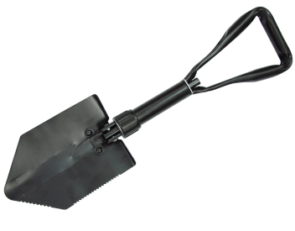
2. Which of the things you have touched left the strongest feelings in you?
A dog, dog’s fur, wet dog
Cat; soft cat
Christmas’ tree
Wooden swoard
Seeds (of wheat) during harvest
Pram with dollies and teddy bear
catapult
Fruits
Boxing gloves
Dewy Grass
„Saperka” shovel

Slide 6
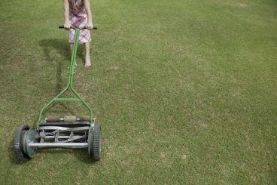
skipping-rope, ball
Beautiful radio that I received on 1st Comunion – it was cold
I remember the most our old house, doors that closed with difficulty, at home we didn’t have floor but ground. I liked to sit on the table and read books, we didn’t have light at home but oil lamp. I liked that house very much because there were my parents, brother and sister
Toys, especially cars and ball
Wooden box made by my grandfather, when I was small girl I liked it very much and I wanted to help to my grandfather who made that boxes
Big, green lawn
Strawberries field
bicycle

Slide 7
Do you remember any noises, sounds, music, songs that had a strong influence on you?
Cds of Led Zeppelin, Modern talking, Phil Collins, Queens, Anna German, Czesław Niemen, Combi „Słodkiego miłego życia”
Shouts during playing
Songs that my almost 100 years old great-grandfather sang me before going asleep, I plan to sing the same songs to my children
combine harvester,
Song from „Czterej pancerni i pies”/ Four tank-men and a dog film
November Rain Guns N' Roses
Christmas carolls
Sound of motor engine
The sound of river
the chirping of crickets
Rustical, regional song sang by father and family
Many songs have big importance to me
Music from weddings and dancings on which I participated with parents
Rivers of babilon by Boney M, Dennis Russos, song „White bear” – this song was very popular during long years and parties
in „remiza” (firemen’s building)

Slide 8
Are there any tastes that you associate with your childhood or your past?
Strawberries (2) bluberries
Chewing gomme
Potatoes fried in fire
Sugar on bread
Fried red beets
poppyseed cake, apple pie made by my grandma
Kogel-mogel yolk stirred with sugar
Marzipan
Sweet rool with white cheese
Milk from the cow and slice of bread with confiture
Fruit soups, tomato soup
„Sunday dinner” = chicken soup, potatoes, roasted chicken and cuccumber with sour cream (mizeria)

Slide 9
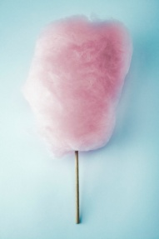
Sweets and chocolates
Strawberries with sour cream
beetroot soup
Taste of homemade saussages
Homemade ice-creams sold from the car
Apples, cherries without chemicals from which we made very good fruit soup, honey was very good more sweet than now, it wa more tasty because came from fields without chemicals
Oranges, chewing gum, candy floss
Raspberries – now I love it, when I was child I hated this
Because I helped to gather it
Cheese cake

Slide 10
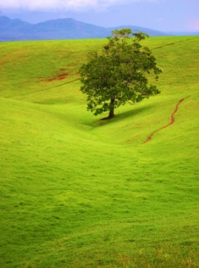
Can you think of any smells that you will never forget?
Smell of forest, blueberries, Flowers on the meadow
smell of baking cake, of chicken soup, sauerkraut stew
Fresh bread, bud with apples
Smell of fresh sausage
Apple soap
Almond’s candies
Smell of flowering apple trees, I remember smell of fresh saussage which was twice a yer on Eater and on Christmas, everything was good because I was young
circus
Grass that was just cut
Burning wood
Smell of air after thunderstorm
London burbary – my favourite perfums
Lilly flowers → funeral

Slide 11
Are there any historical events which had an impact on you or somebody close to you?
Lech Wałęsa
Strike on WSK (helicopter manufacturer in Świdnik)
Death of John Paul II
Poland’s entry to European Union
II word war
Memories of my father about the war and resistance movement
Martial law in Poland/ Stan wojenny
When I was 9 in our countryside come international circus. There were many people beacause the theathre was beautful. Suddenly there was an attack, men was arrested, among whom was my dad, fortunately he come back home soon. For me it was sad and misundestoond.

Slide 12
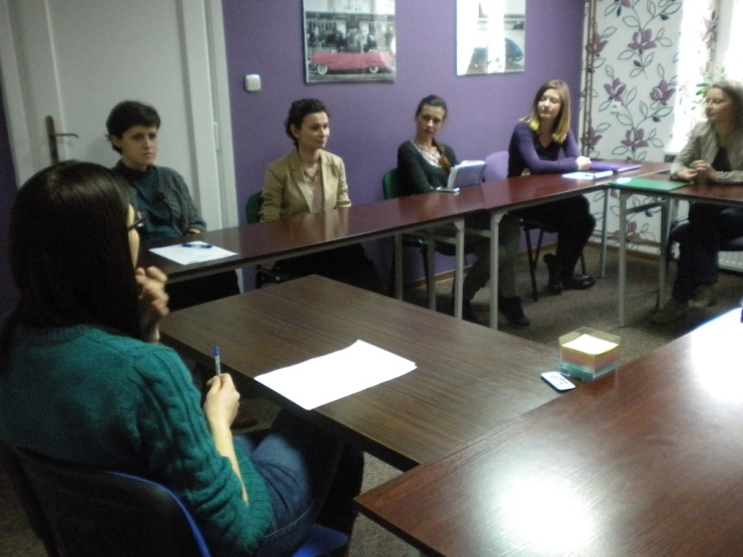
How Much of Your Memory Is True?
New research shows that memories are constantly being re-written by our minds.
Article in Discover Magazine http://discovermagazine.com/2009/jul-aug/03-how-much-of-your-memory-is-true#.UYmKNqKvaSo

Slide 13
